Slide 1
Lecture 16: Graph: Basic Concepts
Keren Zhu
kerenzhu@cse.cuhk.edu.hk

Slide 2
Outline
A graph is an abstract data type for storing adjacency relations
We start with definitions:
Vertices, edges, degree and sub-graphs
We will describe paths in graphs
Simple paths and cycles
Definition of connectedness
Weighted graphs
We will then reinterpret these in terms of directed graphs
Directed acyclic graphs

Slide 3
Outline
We will define an Undirected Graph ADT as a collection of vertices or nodes
V = {v₁, v₂, ..., v_{n}}
The number of vertices is denoted by
|V| = n
Associated with this is a collection E of unordered pairs {v_{i}, v_{j}} termed edges or arcs which connect the vertices
There are a number of data structures that can be used to implement abstract undirected graphs
Adjacency matrices
Adjacency lists

Slide 4
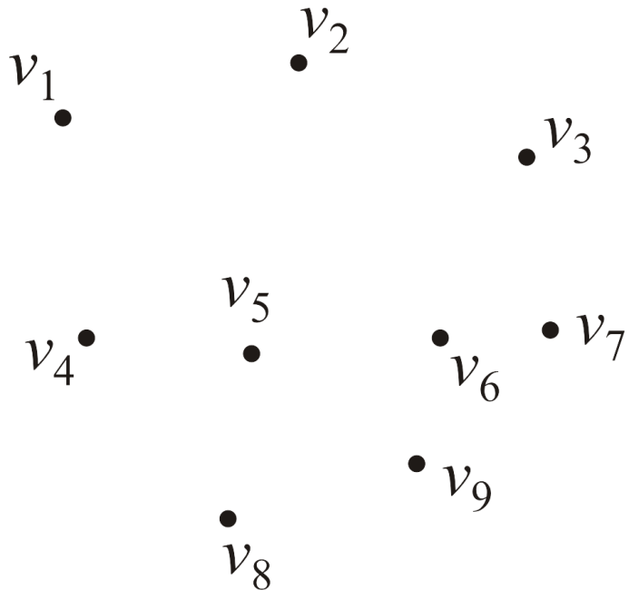
Graphs
Consider this collection of vertices
V = {v₁, v₂, ..., v₉}
where |V| = n

Slide 5
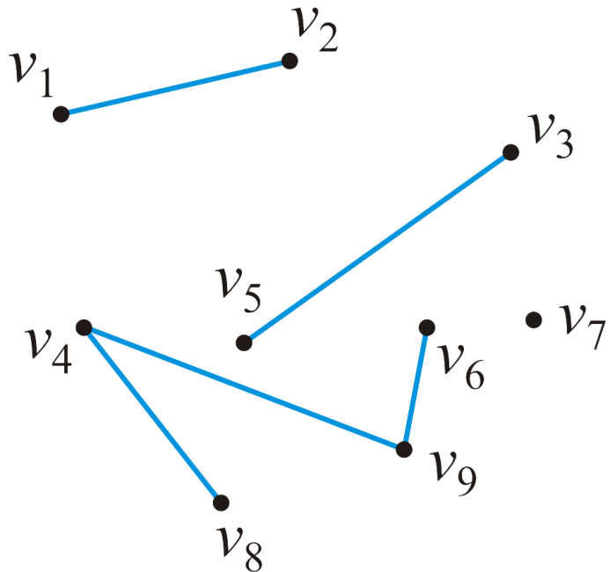
Undirected graphs
Associated with these vertices are |E| = 5 edges
E = {{v₁, v₂}, {v₃, v₅}, {v₄, v₈}, {v₄, v₉}, {v₆, v₉}}
The pair {v_{j} , v_{k}} indicates that both vertex v_{j} is adjacent to vertex v_{k} and vertex v_{k} is adjacent to vertex v_{j}

Slide 6
Undirected graphs
We will assume in this course that a vertex is never adjacent to itself
For example, {v₁, v₁} will not define an edge
The maximum number of edges in an undirected graph is

Slide 7
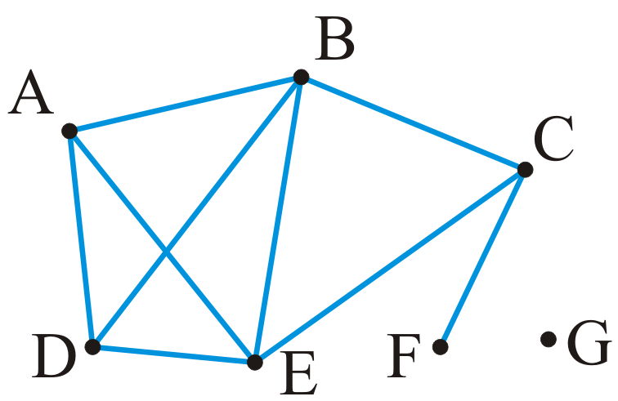
An undirected graph
Example: given the |V| = 7 vertices
V = {A, B, C, D, E, F, G}
and the |E| = 9 edges
E = {{A, B}, {A, D}, {A, E}, {B, C}, {B, D}, {B, E}, {C, E}, {C, F}, {D, E}}

Slide 8
Degree
The degree of a vertex is defined as the number of adjacent vertices
degree(A) = degree(D) = degree(C) = 3
degree(B) = degree(E) = 4
degree(F) = 1 degree(G) = 0
Those vertices adjacent to a given vertex are its neighbors

Slide 9
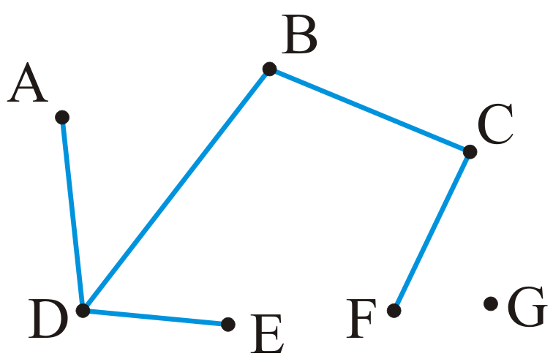

Sub-graphs
A sub-graph of a graph a subset of the vertices and a subset of the edges that connected the subset of vertices in the original graph

Slide 10
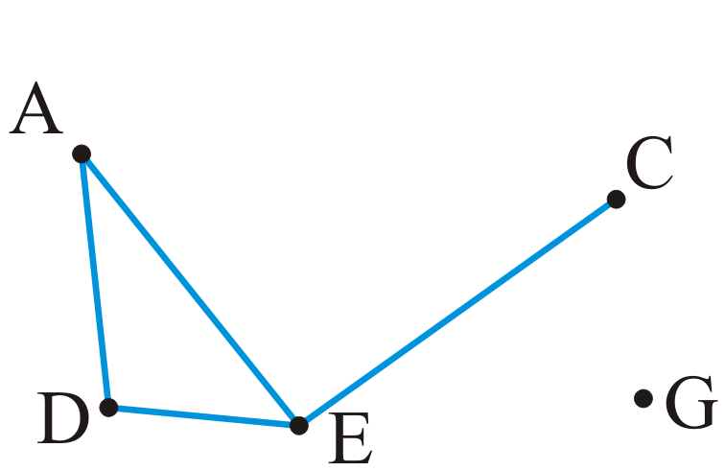
Vertex-induced sub-graphs
A vertex-induced sub-graph is a subset of a the vertices where the edges are all edges in the original graph that originally

Slide 11
Paths
A path in an undirected graph is an ordered sequence of vertices
(v₀, v₁, v₂, ..., v_{k})
where {v_{j – 1}, v_{j}} is an edge for j = 1, ..., k
Termed a path from v₀ to v_{k}
The length of this path is k

Slide 12
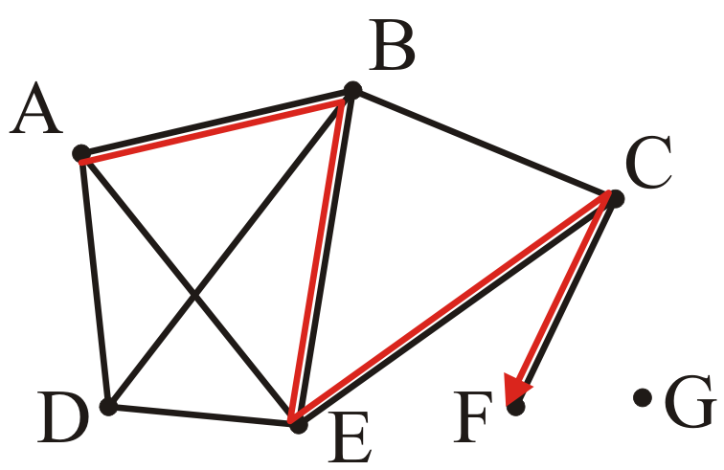
Paths
A path of length 4:
(A, B, E, C, F)

Slide 13
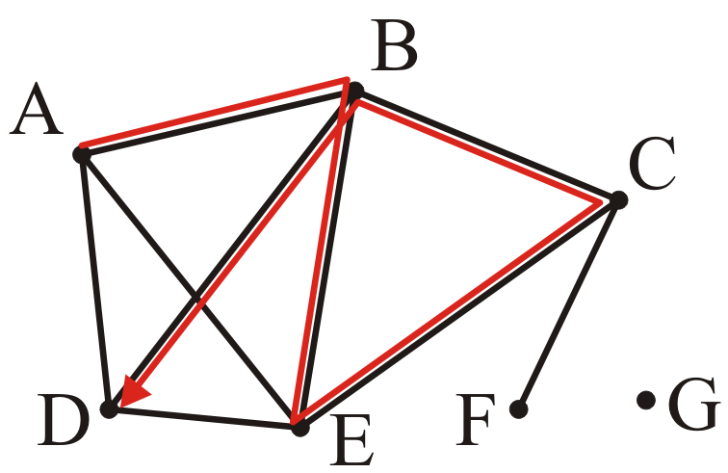
Paths
A path of length 5:
(A, B, E, C, B, D)

Slide 14
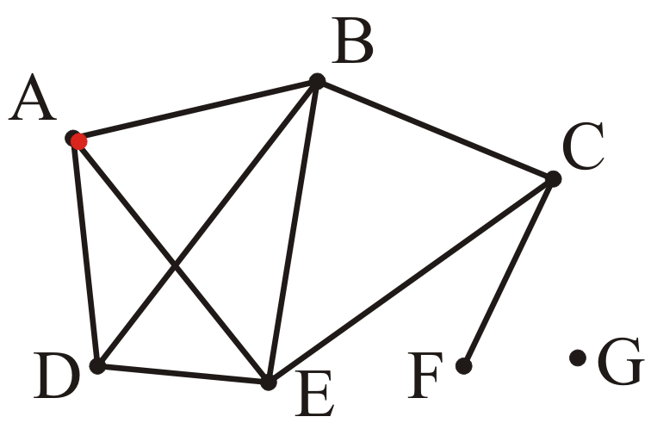
Paths
A trivial path of length 0:
(A)

Slide 15
Simple paths
A simple path has no repetitions other than perhaps the first and last vertices
A simple cycle is a simple path of at least two vertices with the first and last vertices equal
Note: these definitions are not universal

Slide 16
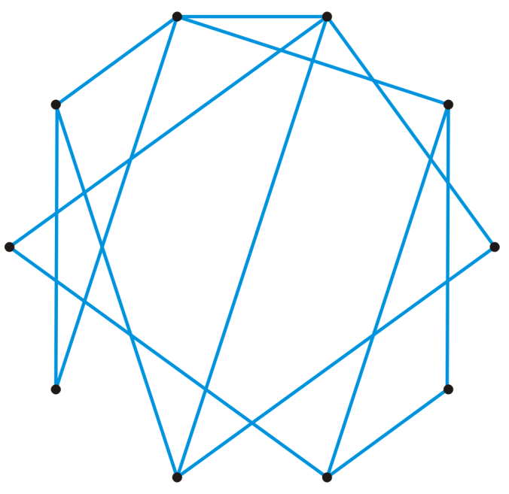
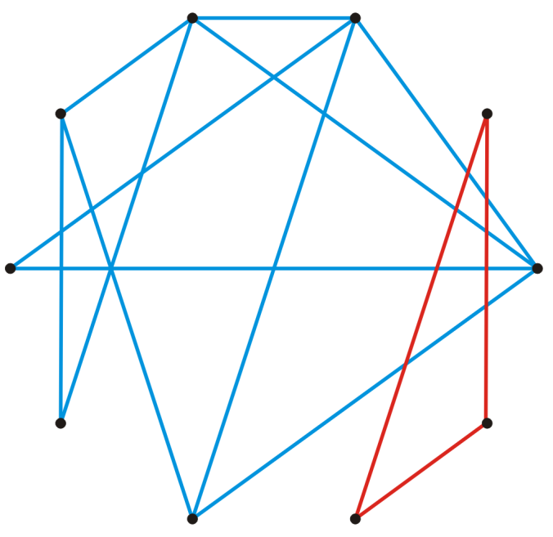
Connectedness
Two vertices v_{i}, v_{j} are said to be connected if there exists a path from v_{i} to v_{j}
A graph is connected if there exists a path between any two vertices
A connected graph
An unconnected graph

Slide 17
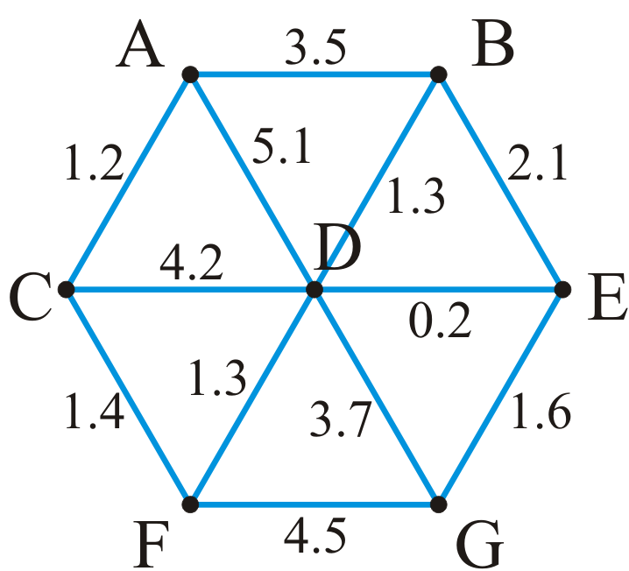
Weighted graphs
A weight may be associated with each edge in a graph
This could represent distance, energy consumption, cost, etc.
Such a graph is called a weighted graph
Pictorially, we will represent weights by numbers next to the edges

Slide 18
Weighted graphs
The length of a path within a weighted graph is the sum of all of the edges which make up the path
The length of the path (A, D, G) in the following graph is 5.1 + 3.7 = 8.8

Slide 19
Weighted graphs
Different paths may have different weights
Another path is (A, C, F, G) with length 1.2 + 1.4 + 4.5 = 7.1

Slide 20
Weighted graphs
Problem: find the shortest path between two vertices
Here, the shortest path from A to H is (A, C, F, D, E, G) with length 5.7

Slide 21
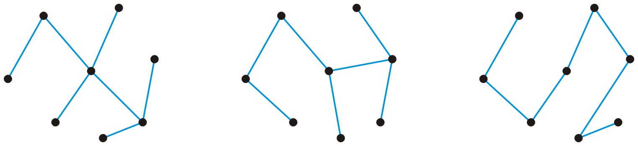
Trees
A graph is a tree if it is connected and there is a unique path between any two vertices
Three trees on the same eight vertices
Consequences:
The number of edges is |E| = |V| – 1
The graph is acyclic, that is, it does not contain any cycles
Adding one more edge must create a cycle
Removing any one edge creates two disjoint non-empty sub-graphs

Slide 22
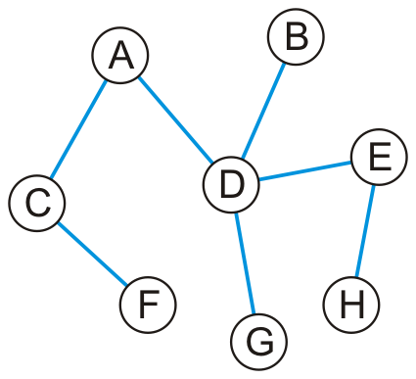
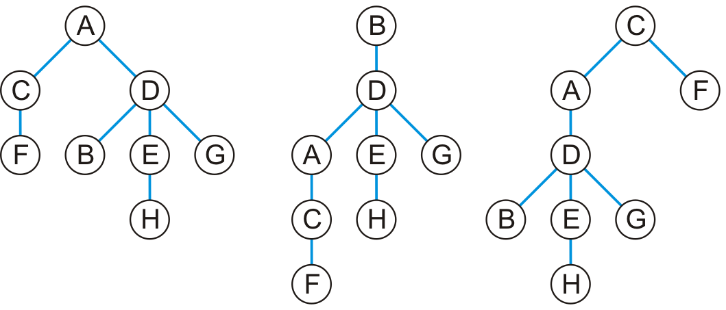
Trees
Any tree can be converted into a rooted tree by:
Choosing any vertex to be the root
Defining its neighboring vertices as its children
and then recursively defining:
All neighboring vertices other than that one designated its parent are now defined to be that vertices children
Given this tree, here are three rooted trees associated with it

Slide 23
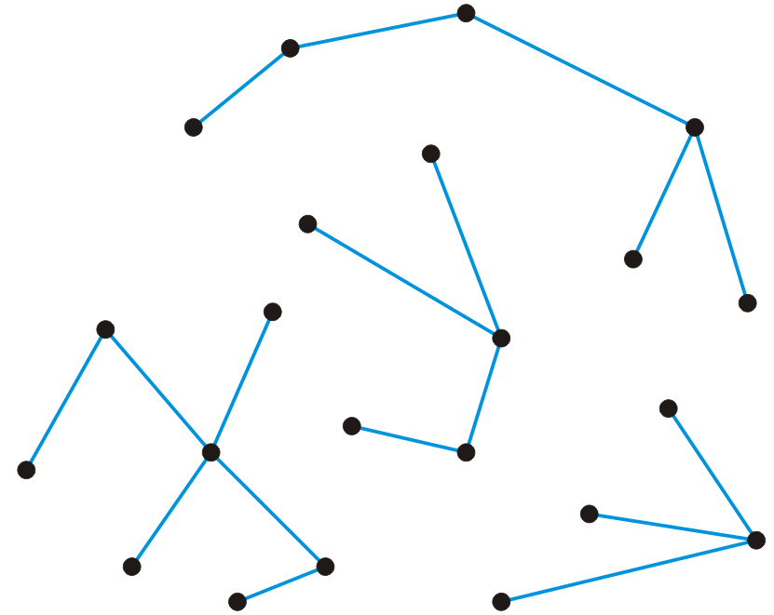
Forests
A forest is any graph that has no cycles
Consequences:
The number of edges is |E| < |V|
The number of trees is |V| – |E|
Removing any one edge adds one more tree to the forest
Here is a forest with 22 vertices and 18 edges
There are four trees

Slide 24
Directed graphs
In a directed graph, the edges on a graph are be associated with a direction
Edges are ordered pairs (v_{j}, v_{k}) denoting a connection from v_{j} to v_{k}
The edge (v_{j}, v_{k}) is different from the edge (v_{k}, v_{j})
Streets are directed graphs:
In most cases, you can go two ways unless it is a one-way street

Slide 25
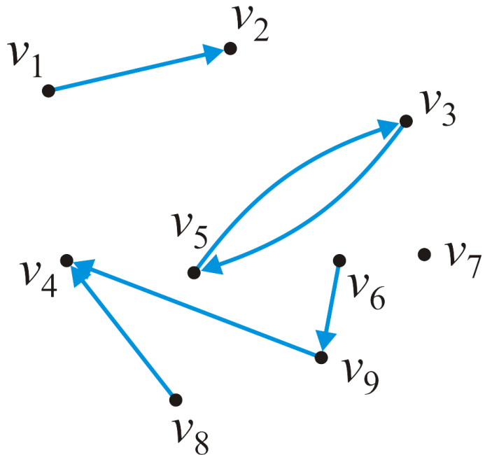
Directed graphs
Given our graph of nine vertices V = {v₁, v₂, …v₉}
These six pairs (v_{j} , v_{k}) are directed edges
E = {(v₁, v₂), (v₃, v₅), (v₅, v₃), (v₆, v₉), (v₈, v₄), (v₉, v₄)}

Slide 26
Directed graphs
The maximum number of directed edges in a directed graph is

Slide 27
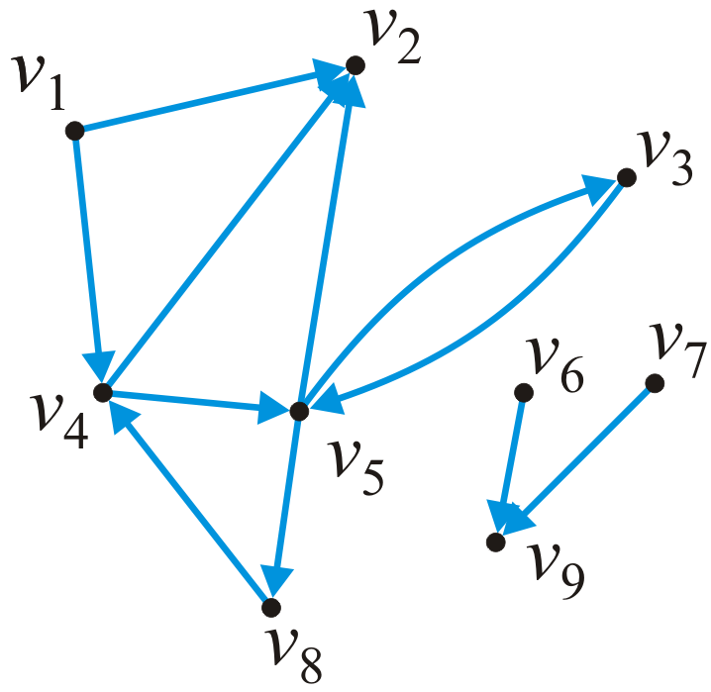
In and out degrees
The degree of a vertex must be modified to consider both cases:
The out-degree of a vertex is the number of vertices which are adjacent to the given vertex
The in-degree of a vertex is the number of vertices which this vertex is adjacent to
In this graph:
in_degree(v₁) = 0 out_degree(v₁) = 2
in_degree(v₅) = 2 out_degree(v₅) = 3

Slide 28
Sources and sinks
Some definitions:
Vertices with an in-degree of zero are described as sources
Vertices with an out-degree of zero are described as sinks
In this graph:
Sources: v₁, v₆, v₇
Sinks: v₂, v₉

Slide 29
Paths
A path in a directed graph is an ordered sequence of vertices
(v₀, v₁, v₂, ..., v_{k})
where (v_{j – 1}, v_{j}) is an edge for j = 1, ..., k
A path of length 5 in this graph is (v₁, v₄, v₅, v₃, v₅, v₂)
A simple cycle of length 3 is (v₈, v₄, v₅, v₈)

Slide 30
Connectedness
Two vertices v_{j}, v_{k} are said to be connected if there exists a path from v_{j} to v_{k}
A graph is strongly connected if there exists a directed path between any two vertices
A graph is weakly connected there exists a path between any two vertices that ignores the direction
In this graph:
The sub-graph {v₃, v₄, v₅, v₈} is strongly connected
The sub-graph {v₁, v₂, v₃, v₄, v₅, v₈} is weakly connected

Slide 31
Weighted directed graphs
In a weighted directed graphs, each edge is associated with a value
Unlike weighted undirected graphs, if both (v_{j}, v_{k}) and (v_{j}, v_{k}) are edges, it is not required that they have the same weight
6.4
7.5
7.3
6.8
6.7
5.9
4.1
3.2
4.7
5.4
4.5

Slide 32
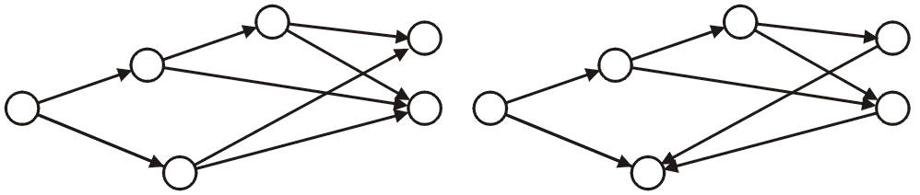
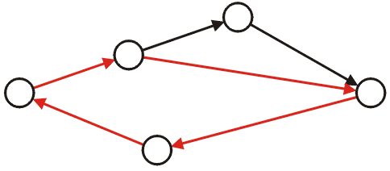
Directed acyclic graphs
A directed acyclic graph is a directed graph which has no cycles
These are commonly referred to as DAGs
They are graphical representations of partial orders on a finite number of elements
These two are DAGs:
This directed graph is not acyclic:

Slide 33
Directed acyclic graphs
Applications of directed acyclic graphs include:
The parse tree constructed by a compiler
A reference graph that can be garbage collected using simple reference counting
Dependency graphs such as those used in instruction scheduling and makefiles
Dependency graphs between classes formed by inheritance relationships in object-oriented programming languages
Information categorization systems, such as folders in a computer
Directed acyclic word graph data structure to memory-efficiently store a set of strings (words)
Reference: http://en.wikipedia.org/wiki/Directed_acyclic_graph

Slide 34
Representations
How do we store the adjacency relations?
Binary-relation list
Adjacency matrix
Adjacency list

Slide 35
Binary-relation list
The most inefficient is a relation list:
A container storing the edges
{(1, 2), (1, 4), (3, 5), (4, 2), (4, 5), (5, 2), (5, 3), (5, 8), (6, 9), (7, 9), (8, 4)}
Requires Θ(|E|) memory
Determining if v_{j} is adjacent to v_{k} is O(|E|)
Finding all neighbors of v_{j} is Θ(|E|)

Slide 36
Adjacency matrix
Requiring more memory but also faster, an adjacency matrix
The matrix entry (j, k) is set to true if there is an edge (v_{j}, v_{k})
Requires Θ(|V|²) memory
Determining if v_{j} is adjacent to v_{k} is O(1)
Finding all neighbors of v_{j} is Θ(|V|)
 | 1 | 2 | 3 | 4 | 5 | 6 | 7 | 8 | 9
1 |  | T |  | T
2
3 |  |  |  |  | T
4 |  | T |  |  | T
5 |  | T | T |  |  |  |  | T
6 |  |  |  |  |  |  |  |  | T
7 |  |  |  |  |  |  |  |  | T
8 |  |  |  | T
9

Slide 37
Adjacency list
1 • → 2 → 4
2 •
3 • → 5
4 • → 2 → 5
5 • → 2 → 3 → 8
6 • → 9
7 • → 9
8 • → 4
9 •
Most efficient for algorithms is an adjacency list
Each vertex is associated with a list of its neighbors
Requires Θ(|V| + |E|) memory
On average:
Determining if v_{j} is adjacent to v_{k} is
Finding all neighbors of v_{j} is

Slide 38
The Graph ADT
The Graph ADT describes a container storing an adjacency relation
Queries include:
The number of vertices
The number of edges
List the vertices adjacent to a given vertex
Are two vertices adjacent?
Are two vertices connected?
Modifications include:
Inserting or removing an edge
Inserting or removing a vertex (and all edges containing that vertex)
The run-time of these operations will depend on the representation

Slide 39
Summary
In this topic, we have covered:
Basic graph definitions
Vertex, edge, degree, adjacency
Paths, simple paths, and cycles
Connectedness
Weighted graphs
Directed graphs
Directed acyclic graphs
We will continue by looking at a number of problems related to graphs

Slide 40
(Not in exam) PageRank algorithm
Choosing which graph representation to use is depends on the application
On algorithm: e.g. adjacency list is more efficient in adding/deleting a vertex or edge
On graph: e.g. the sparsity of the graph
Usually, writing the codes with adjacency list is easier, but for some application, thinking the graph as matrices can be helpful
PageRank algorithm is an example of using adjacency matrix is more efficient
Originally published as “The Anatomy of a Large-Scale Hypertextual Web Search Engine” in 1998 by Sergey Brin and Larry Page

Slide 41
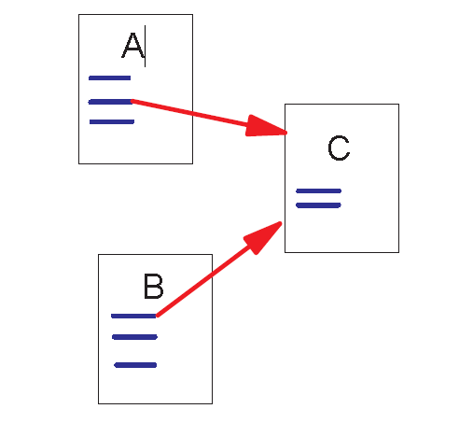
(Not in exam) PageRank algorithm
Problem: querying the keyword in webpages is straightforward, but what pages shall a search engine engine shows to the users?
Million of the webpages
Need to identify the “important” ones
The idea is to use hyperlinks between the webpages to identify those are important
Backlinks and Forward links:
A and B are C’s backlinks
C is A and B’s forward link
C maybe more important here

Slide 42
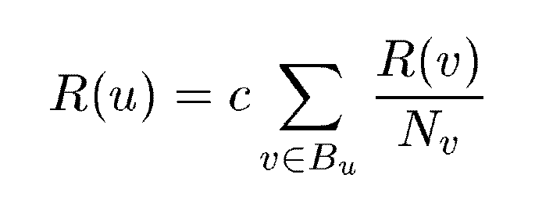
(Not in exam) PageRank algorithm
We can define a rank score for each page
A link is like a “vote”, and the weight of the “vote” is depending on the rank of the source webpage
The computation is efficient using matrix representation
u: a web page
B_{u}: the set of u’s backlinks
N_{v}: the number of forward links of page v
c: the normalization factor to make ||R||_{L1} = 1 (||R||_{L1}= |R₁ + … + R_{n}|)

Slide 43
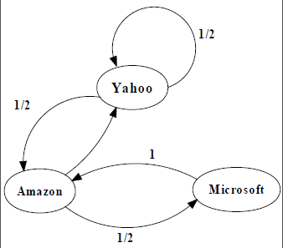
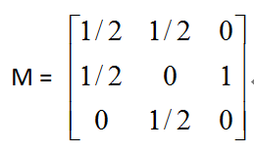
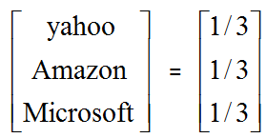
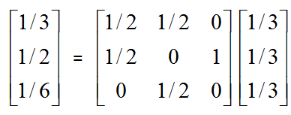
(Not in exam) PageRank algorithm
PageRank Calculation: first iteration

Slide 44
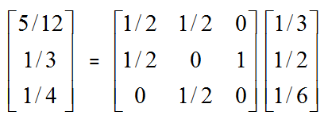
(Not in exam) PageRank algorithm
PageRank Calculation: second iteration

Slide 45
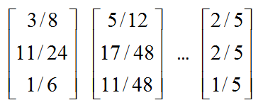
(Not in exam) PageRank algorithm
Convergence after some iterations

Slide 46
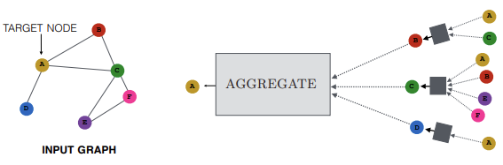
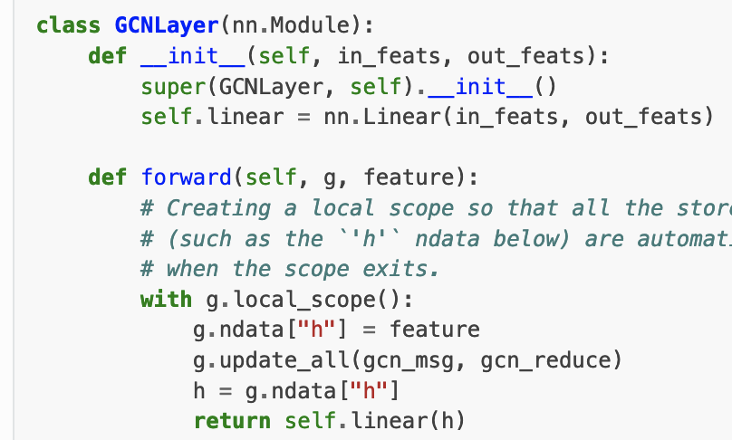
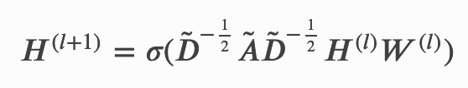
(Not in exam) message-passing and the matrix form
Suppose we want to make it further to introduce a content/attribute-aware learnable transformation
Message-passing GNN aggregate the neighbor information and transform over a learnable nonlinear function
Mathematical formulation of GCN layer
An example of message-passing scheme of GCN

